Slide 1
Volume

Slide 2
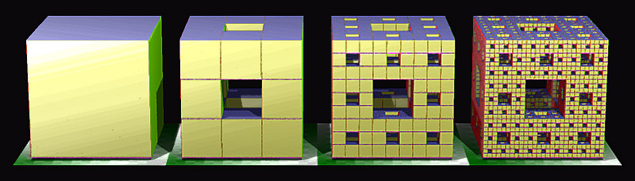
Do It Now:
The Merger Sponge is created by removing the middle faces from the front, side and top of a cube. Each remaining cube then has the same operation performed on it.
Research the Merger Sponge for ~5 to 10 minutes and write a short summation about what happens to the surface area and the volume with repeated iterations. What is the volume after 2 iterations? What is the surface area after 2 iterations?

Slide 3
Volume
Success Criteria
Learning Intentions
By the end of this lesson, students will be able to:
Determine the volume for a range of 3-dimensional solids such as cubes, rectangular prisms, triangular prisms, cylinders, spheres, cones, pyramids and other composite solids.
Convert 3-dimensional units appropriately.
Apply formulas when formula’s are known and breakdown solids into their component parts when required.
I will know that I have been successful if I can:
Use cubic units at all times
Define volume in their own words
Use formula to determine volume
Break solids into component parts.
State what a prism is and how a prism’s volume is determined.

Slide 4
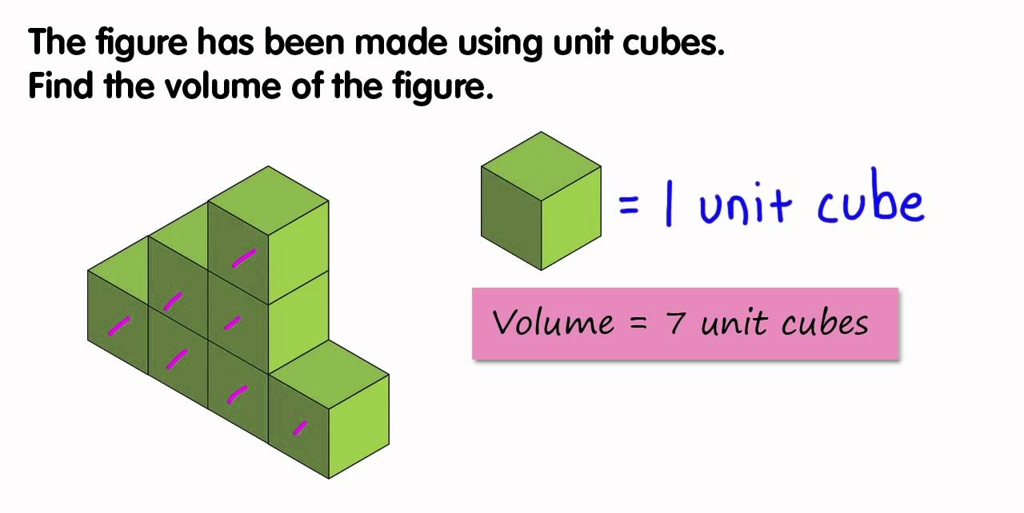
How is volume measured?
Volume is measured in cubic units. A cubic centimetre is a cube that is 1cm x 1cm x 1cm.

Slide 5
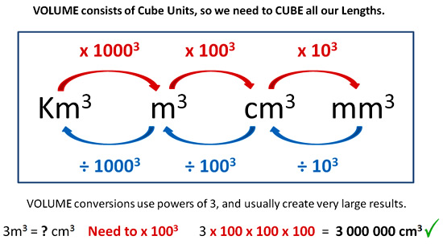
Converting metric measurements of volume
The best way to convert units in any problem is to convert them before you get started.
If you cannot convert your linear units before you get started, then you can convert from mm³ to cm³ to m³ or to km³ using some simple conversions.

Slide 6








































Converting Units Examples
Convert 3450mm to cm
Convert 4.05km to m

Slide 7
















Converting Units Examples
Convert 2000cm² to m²
Convert 5.6m² to mm²

Slide 8













Converting Units Examples
Convert 1.5cm³ to mm³
Convert 18.2m³ to cm³

Slide 9
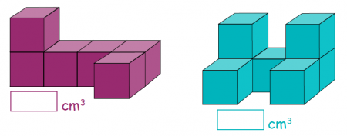
Basics of Volume
Volume at its most simple form is how many cubic units make up a 3-dimensional solid.
For less rectangular solids, we look at the total space that the solid occupies in 3-dimensions, using a standard measurement, cm³ or m³ etc.
1
3
6
4
5
2
2
3
7
6
4
1
5
6
7

Slide 10
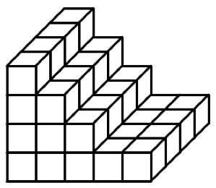
Volume of Prisms
Volume at its most simple form is how many cubic units make up a 3-dimensional solid.
Prisms are a lot easier to determine the volume of.
By definition, a prism has the same cross sectional area throughout the entire shape, so if we imagine cutting the shape into 1cm or 1mm or 1m slices, we can work out the volume by determining the cross-sectional face’s area and multiplying this by the number of slices.
The volume of this shape is 4 lots of 11, or 4 x 11 = 44cm³
4
3
2
1
1
2
3
4
5
6
7
8
9
10
11

Slide 11
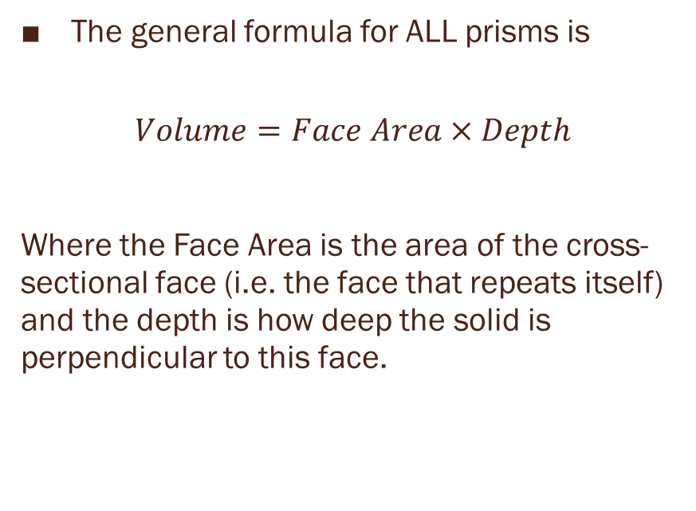
Volume of Prisms
It doesn’t make much sense to count every single block, so we use formulae to help us.
The general formula for ALL prisms is
$$Volume=Face Area×Depth$$
Where the Face Area is the area of the cross-sectional face (i.e. the face that repeats itself) and the depth is how deep the solid is perpendicular to this face.
Face Area
Depth

Slide 12
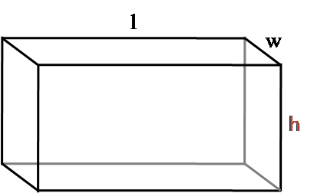
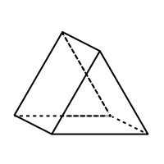
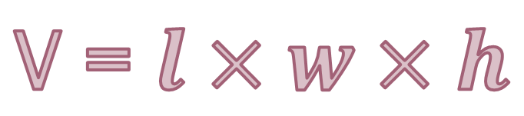
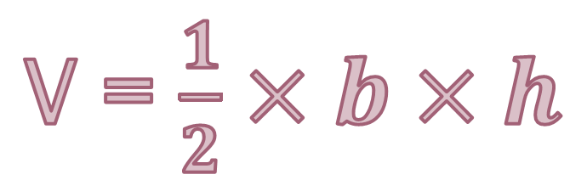
Volume of Prisms
It doesn’t make much sense to count every single block, so we use formulae to help us.
Some prisms have a specific formula to help us calculate their volume:
Shape | Volume
Rectangular Prisms
Triangular Prisms
V = $l×w×h$
V = $\frac{1}{2}×b×h$
h
d
b

Slide 13
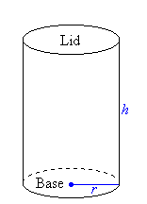
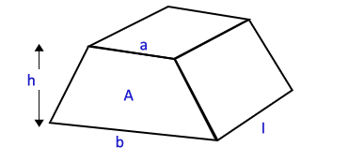
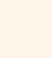
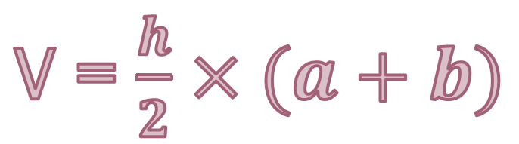
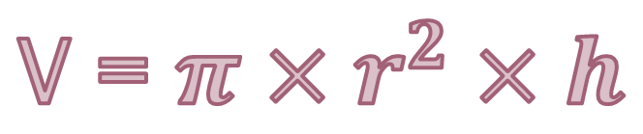
Volume of Prisms
It doesn’t make much sense to count every single block, so we use formulae to help us.
Some prisms have a specific formula to help us calculate their volume:
Shape | Volume
Cylinder
Trapezoidal Prisms
V = $π×r^{2}×h$
V = $\frac{h}{2}×(a+b)$

Slide 14
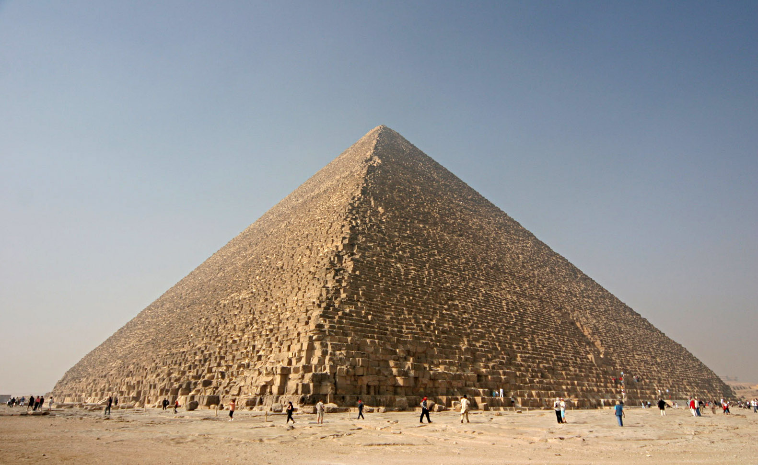
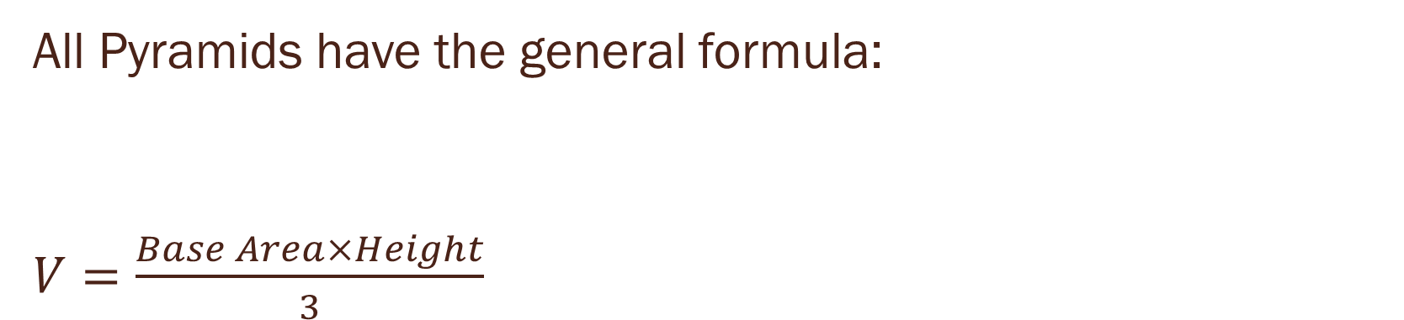
Pyramids
All Pyramids have the general formula:
$V=\frac{Base Area×Height}{3}$

Slide 15
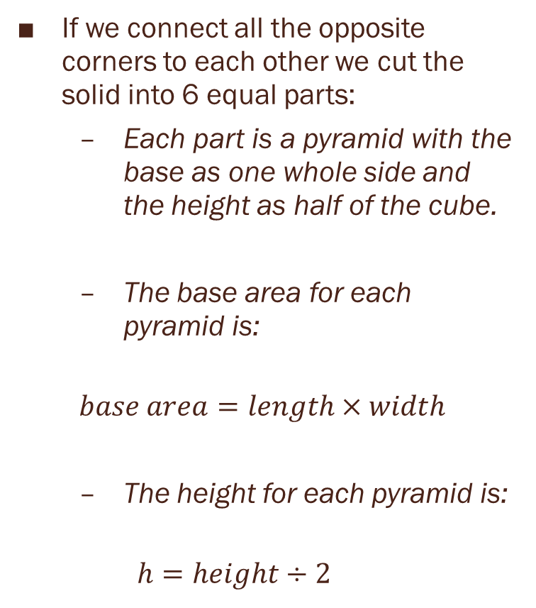
Picture a 1cm cube:
If we connect all the opposite corners to each other we cut the solid into 6 equal parts:
Each part is a pyramid with the base as one whole side and the height as half of the cube.
The base area for each pyramid is:
$$base area=length×width$$
The height for each pyramid is:
$$h=height÷2$$

Slide 16
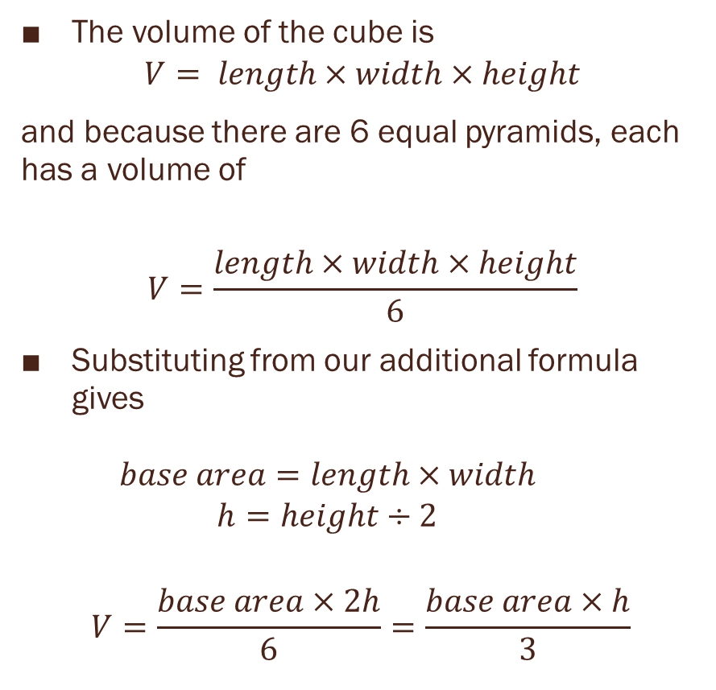
Picture a 1cm cube:
The volume of the cube is
$$V= length×width×height$$
and because there are 6 equal pyramids, each has a volume of
$$V=\frac{length×width×height}{6}$$
Substituting from our additional formula gives
$$base area=length×width$$
$$h=height÷2$$
$$V=\frac{base area×2h}{6}=\frac{base area×h}{3}$$

Slide 17
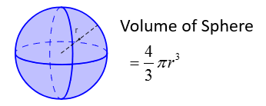
Spheres:
The volume of a sphere is determined by the formula:

Slide 18
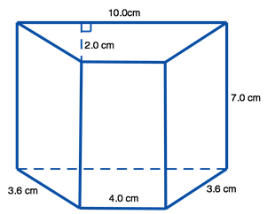

Practice:
Calculate the volume of the following solids:

Slide 19
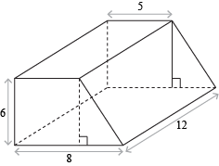
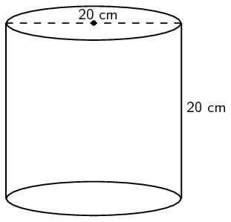
Practice:
Calculate the volume of the following solids:

Slide 20
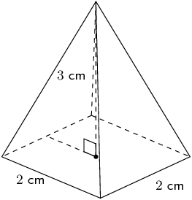
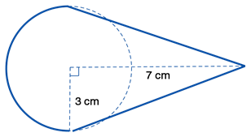
Practice:
Calculate the volume of the following solids:

Slide 21



Practice:
Calculate the volume of the following solids:

Slide 22
Practice:
Calculate the volume of the following solids:

Slide 23
Practice:
Calculate the volume of the following solids:

Slide 24
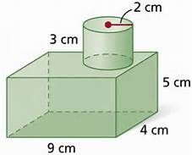
Composite Solids
When working with composite solids, the steps are very similar to surface area:
Split the solid up into manageable solids.
Identify if they need to be added or subtracted from the total volume
Work out the volume of each partial solid
Add your answers together to get a total volume

Slide 25
Composite Solids
When working with composite solids, the steps are very similar to surface area:
Split the solid up into manageable solids.
Identify if they need to be added or subtracted from the total volume
All need to be added together.
2
1

Slide 26
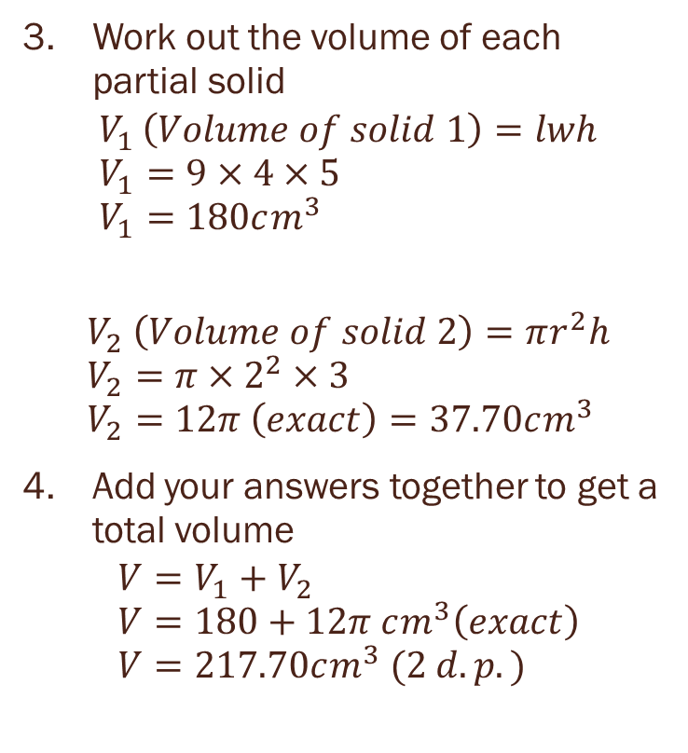
Composite Solids
When working with composite solids, the steps are very similar to surface area:
Work out the volume of each partial solid
$$V_{1 }\left(Volume of solid 1\right)=lwh \\ V_{1}=9×4×5 \\ V_{1}=180cm^{3}$$
$$V_{2} \left(Volume of solid 2\right)=πr^{2}h \\ V_{2}=π×2^{2}×3 \\ V_{2}=12π \left(exact\right)=37.70cm^{3}$$
Add your answers together to get a total volume
$$V=V_{1}+V_{2} \\ V=180+12π cm^{3}\left(exact\right) \\ V=217.70cm^{3} (2 d.p.)$$
2
1

Slide 27
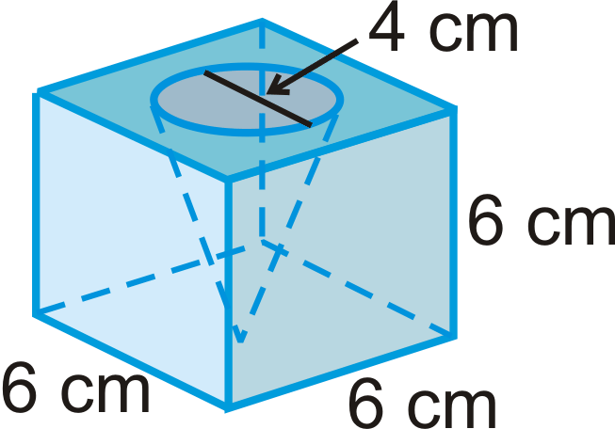
Composite Solids
When working with composite solids, the steps are very similar to surface area:
Split the solid up into manageable solids.
Identify if they need to be added or subtracted from the total volume
The cone will need to be subtracted from the cube
2
1

Slide 28
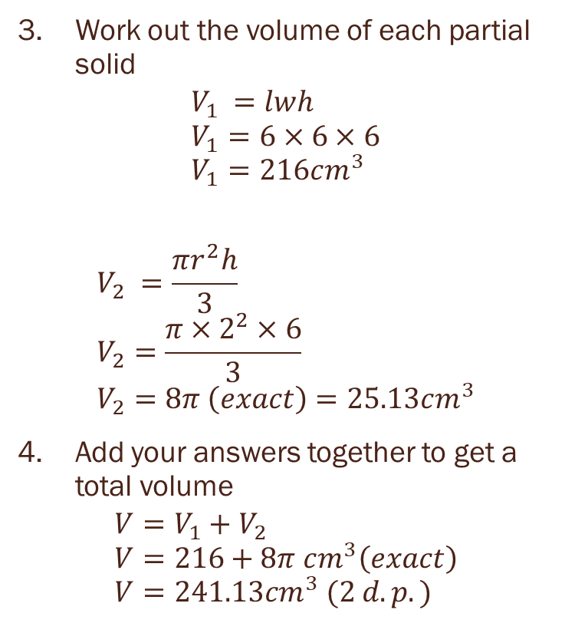
Composite Solids
When working with composite solids, the steps are very similar to surface area:
Work out the volume of each partial solid
$$V_{1 }=lwh \\ V_{1}=6×6×6 \\ V_{1}=216cm^{3}$$
$$V_{2} =\frac{πr^{2}h}{3} \\ V_{2}=\frac{π×2^{2}×6}{3} \\ V_{2}=8π \left(exact\right)=25.13cm^{3}$$
Add your answers together to get a total volume
$$V=V_{1}+V_{2} \\ V=216+8π cm^{3}\left(exact\right) \\ V=241.13cm^{3} (2 d.p.)$$
2
1

